Slide 1
Josh Dean
February 11, 2021
Mayor’s Summit on Homelessness
Housing Heroes

Slide 2

LHC 2020 In Review
Covid-19 Resource Page
Covid-19 Housing Update
LHC Supports Homeless Population
Energy Bill Payment Assistance
Emergency Rental Assistance

Slide 3
What is Housing Heroes?
Statewide Initiative to identify apartment and rental housing opportunities that are move-in ready or have upcoming availability.
Over the course of April and May, 2020, LHC and the state’s continuums of Care launched a non-congregant shelter initiative to temporarily house more than 1,200 homeless individuals in hotels as a preventative measure to keep safe from Covid-19 pandemic.
In November 2020, the state reported 18,213 evacuees from Hurricanes Laura and Delta across Louisiana and Texas.

Slide 4
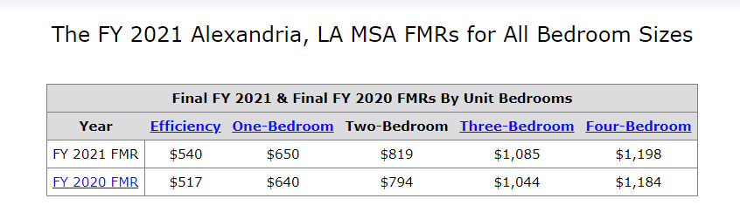
What is Housing Heroes?
Unit must pass Housing Quality Standards (HQS Inspection)
Must Fall within Fair Market Rates
Complete a RAC with LHC
Provide a 1099 for IRS Reporting
Complete all necessary repairs in a timely manner

Slide 5
Why Housing Heroes?
Guaranteed, on-time monthly rent (preferably by direct deposit).
You screen and select applicants.
Tenants receive ongoing support to help them be successful tenants who take care of your property.
Direct contact at Louisiana Housing Corporation to assist with any housing issues or concerns.

Slide 6
Identify available property
List on
LA Housing Search
Case manager identifies
property to rent
Prospective tenant applies and is screened by landlord

Slide 7
Landlord agrees to rent and
unit is inspected
Landlord signs a lease with tenant and a Rental Agreement Contract with LHC
Tenant moves in and LHC pays deposit
LHC pays monthly rent
for terms of RAC

Slide 8
What is the Multifamily Lease and Repair Program?
Allows FEMA to lease and repair or make improvements to existing multifamily rental property for the purpose of providing temporary housing to eligible applicants who are displace due to Hurricane Laura.
Two or more available units previously used as rental property.
Lease the vacant units to FEMA for FEMA’s exclusive use as temporary housing for a term expiring no earlier than February 28, 2022.
Be repairable within 120 days of the date the agreement is approved by FEMA.

Slide 9
What is the Multifamily Lease and Repair Program?
Location: Not in a special flood zone and within reasonable commuting distance to disaster impacted communities and wrap around services.
Include at least one unit repaired or improved to be accessible to applicants with disabilities.
FEMA is looking for properties that are in adjacent parishes or within 50 miles of the parishes designated for direct housing.
Can register your project at https://beta.sam.gov. Contact Marvin Jennings at marvin.r.Jennings@fema.dhs.gov with questions.

Slide 10
https://www.lahousingsearch.org/HousingHeroes.html

Slide 11
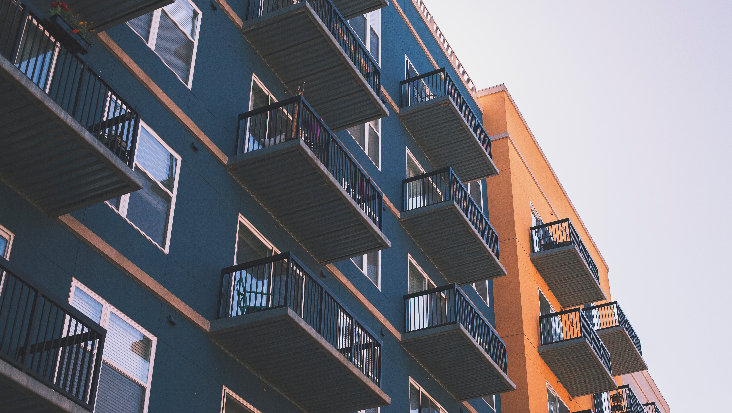

(225) 763-8700 • LHC.LA.GOV

