Slide 1
Presentation by Alexandria Housing Authority Stephan Fontenot Executive Director

Slide 2
City of Alexandria
Thank you to Mayor Hall and the City of Alexandria
Susan Broussard, Chief of Staff
Other team members

Slide 3
Alexandria Housing Authority
Who are we?
In business since 1942.
Largest provider of affordable housing in Central Louisiana
669 units
650 vouchers
35 VASH vouchers
25 dedicated and professional staff

Slide 4
Alexandria Housing Authority
Our mission
Our Commissioners, Staff & Partners
The Alexandria Housing Authority is committed to providing affordable housing, quality of life initiatives and building safe communities one family at a time.

Slide 5
Partnership with local Alexandria VA Medical Center (VAMC)
The Alexandria Housing Authority works together with the Veterans Administration to offer supportive housing to our Veterans. We receive referrals from the V.A. for Veterans who are homeless and seeking housing. The Veteran is connected with Housing Choice Voucher program and after the verification process is complete, a voucher is issued. The Veteran is allowed to utilize the voucher here in the Alexandria area or they may have the option to utilize the voucher in other areas, through the porting process as long as it is in the catchment area for VA services.
Appreciative of leadership & staff of VA Medical Center
Desmona Johnson & Team
Our position on homelessness
Understanding the process
Collaboration
Waiting list/referral
Processing
Vouchers (35)

Slide 6
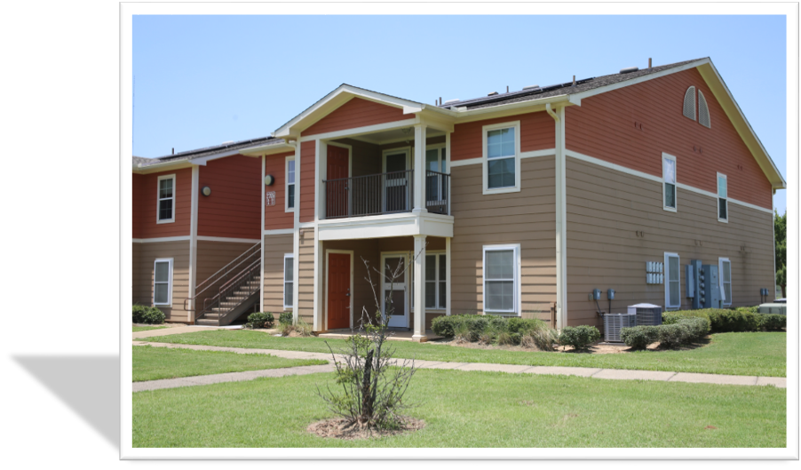
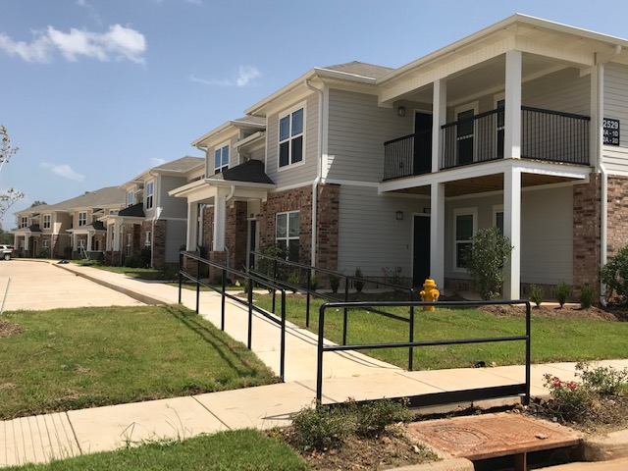
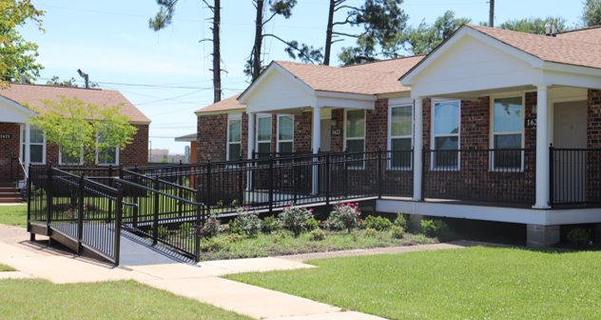
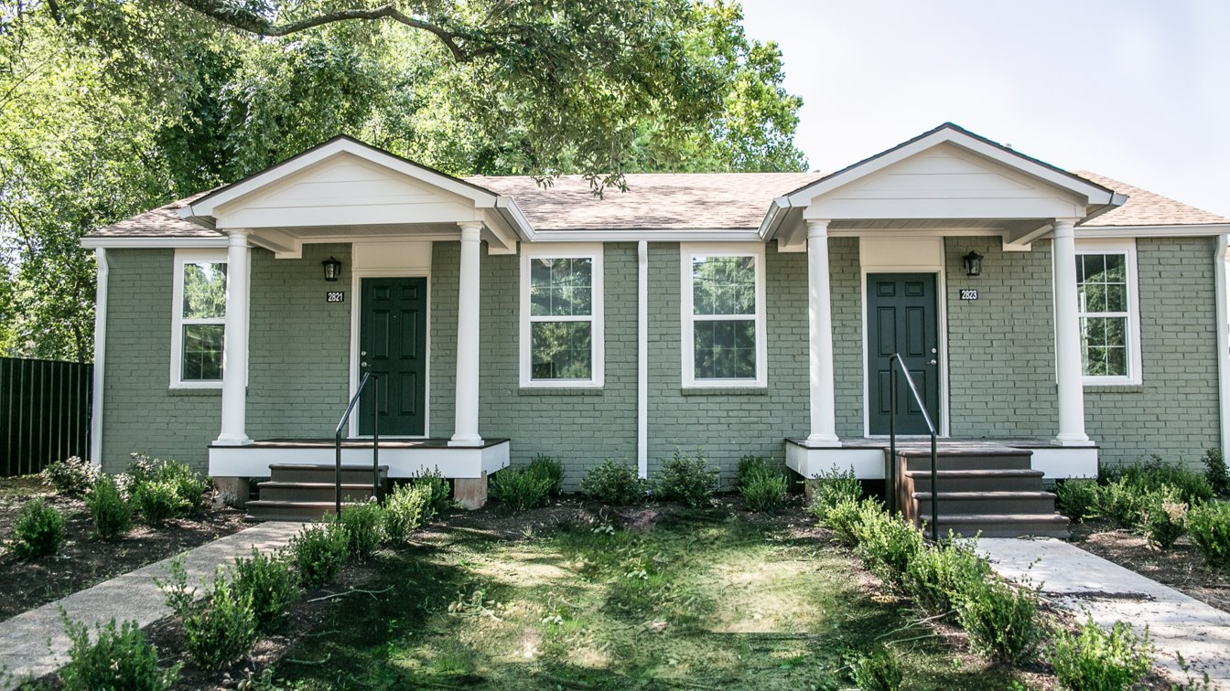
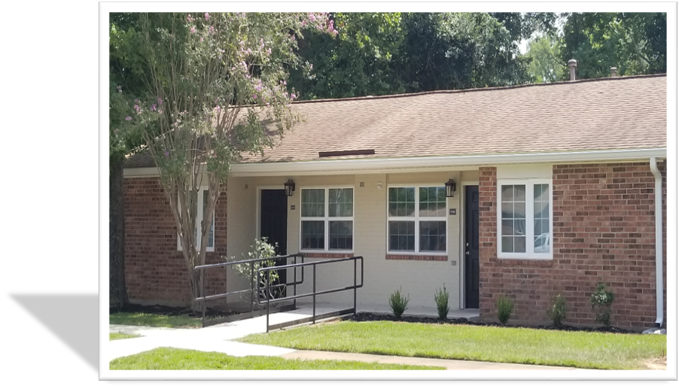
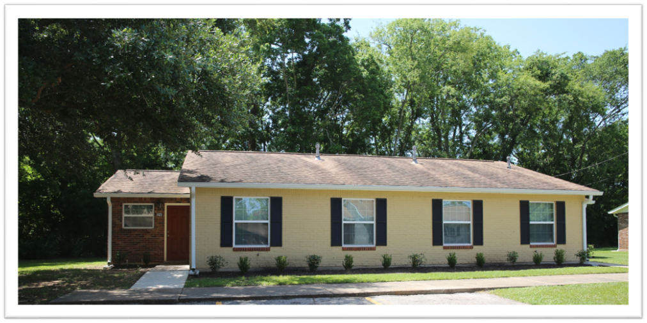
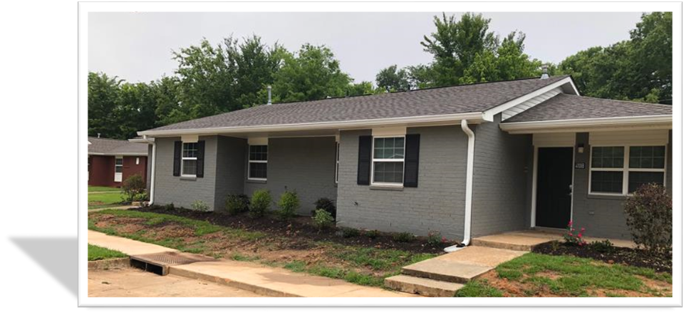
Veterans and Housing Options…
Putting families in places we would want to live!
Housing Choice Voucher Staff
No longer in the Public Housing Business
Rental Assistance Demonstration - -$100 million
9 properties
Tranquil Estates
Garden Gates
Harmony Village
Royal Ridge
Cambridge Place
Magnolia Crossing
Bayou Gardens
Woodhaven
Woodland Pointe
Improving the quality of living for our residents…

Slide 7
Challenges we have faced…
Getting the word out to Veterans
Limited one (1) bedroom units
Move out of units

Slide 8
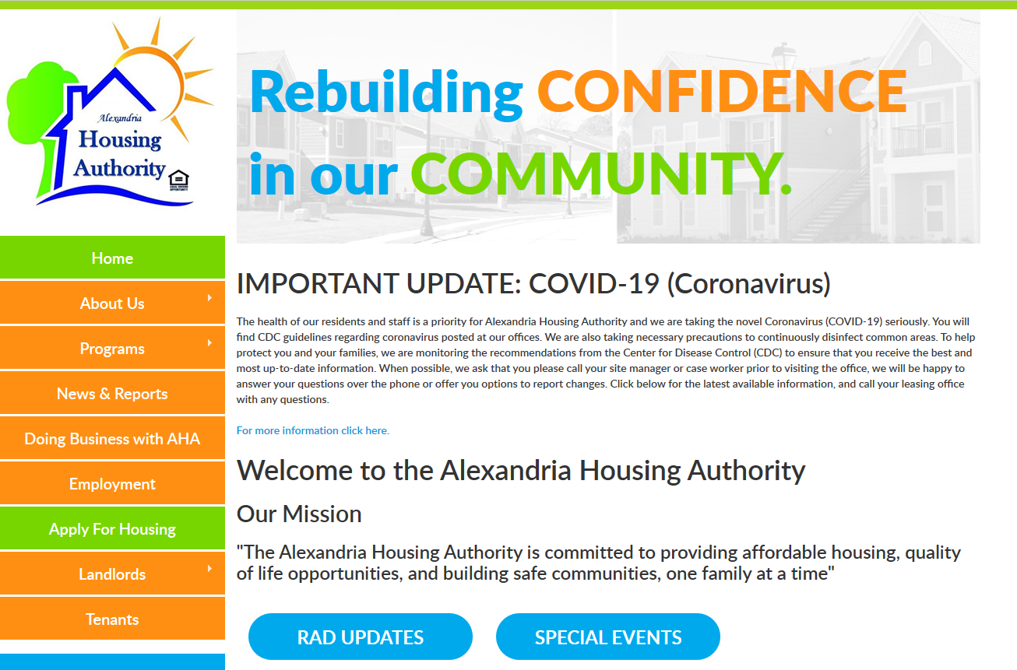
Thank You!
We’re located at 2558 Loblolly Lane Alexandria, LA 71303
Or give us a call at (318) 442-8843
Open Monday – Friday 8:00am-4:30pm
www.alexhousing.org

